Slide 1



with
Ian G. Williams
iwilliams1@gradcenter.cuny.edu
October 23rd, 2023
adapted from
Fall 2021 & 2022 ITP lab slides
by Zachary Mulbauer
Link to slides: https://bit.ly/htmlcss-itp-f23
(or scan QR code)

Slide 2
Agenda
Learning outcomes
Introductions
HTML
Origins & concepts
Nuts & bolts
HTML practice (text, tags, elements, formatting)
4. CSS
Origins & concepts
Nuts & bolts
CSS practice (universal & specific stylesheet)
5. Recommendations and next steps
Resources
Websites
Recommended tutorials

Slide 3
Learning outcomes
Today we’ll learn how to…
Conceptualize hypertext, markup, and stylesheets
Enter basic hypertext in HTML
Add comments to HTML script
Style the paragraph with CSS
Use an online code editor (codepen.io)
Create a coding environment on your computer
Save files on your desktop

Slide 4
What you’ll need
Web browser with Internet access
Access to a text editor software (Textedit or Notepad)
Ability to create and save files on your desktop
A little patience and curiosity

Slide 5

Facilitator background
Name: Ian
Pronouns: he/him/his
Program: 3rd year student in PhD Program in Social Welfare & ITP Certificate, Program Social Media Fellow with GCDI
Research interests: technology adoption and innovation in human services
ITP Project: Working focused on a hypertext-based note-taking tool (Obsidian) as an autoethnographic tool
Tech background: Created websites in early 2000’s in HTML and CSS. Took coursework in JavaScript and D3.JS in PhD. Find coding equally frustrating and fascinating.

Slide 6
Introductions
Name
Pronouns
Program
1 thing you do or would like to do with HTML and/or CSS

Slide 7
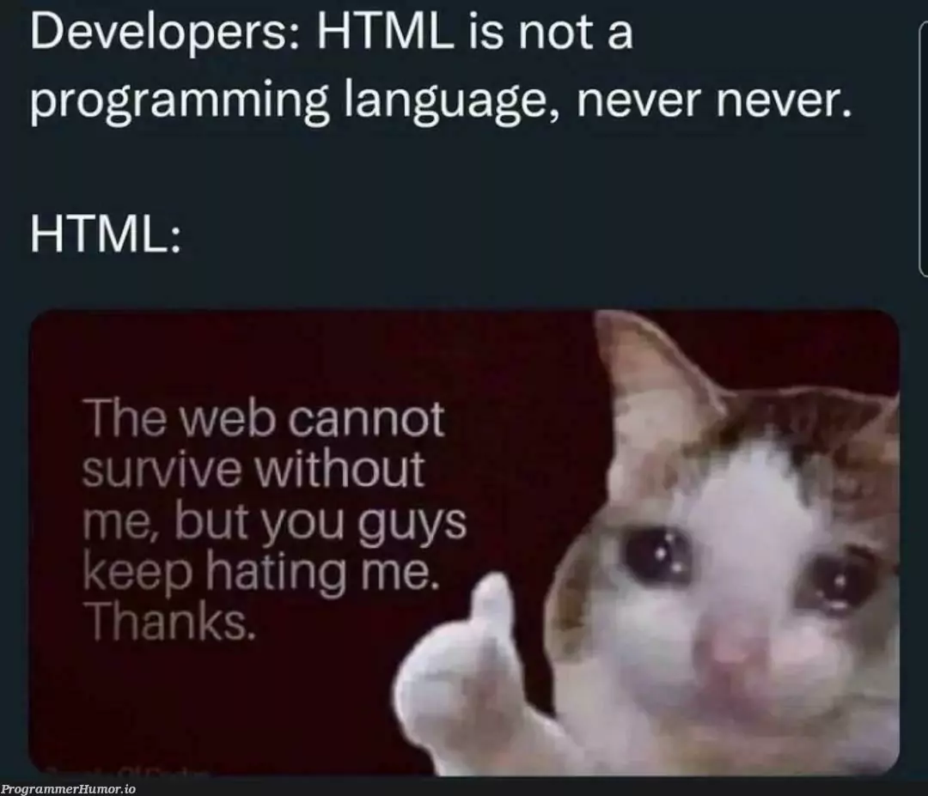
HTML: Overlooked and Undervalued?
image source: programminghumor.io

Slide 8
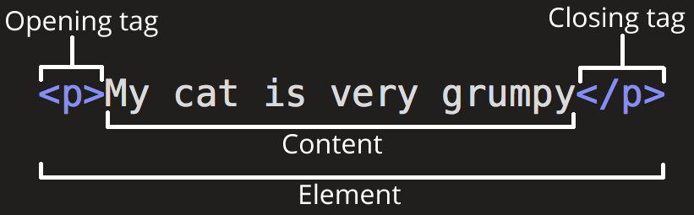
HTML: Anatomy
image source: MDN

Slide 9
HyperText Markup Language (HTML): Origins
First proposed around 1990 by Tim Berners-Lee, a physicist at CERN, the European Organization for Nuclear Research. Current version is HTML5.
Standard at that time for scientific publishing was Standard Generalized Markup Language (SGML).
SGML was highly technical, creating barriers to scientific publication.
Unlike SGML, HTML automated markup process to simplify output.
Content could be translated into front-end (web page) display.
Scientific innovation made online publishing (and information dissemination) much easier.
Also made design of output responsive to user activity.

Slide 10
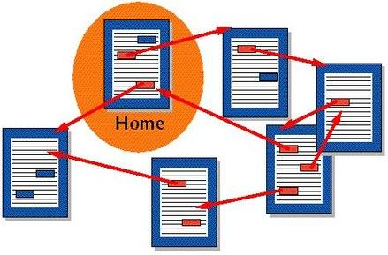
HTML: HyperText Explained
Text that links to other documents or information without containing it
Allows for display of materials by referencing and retrieving them
A dictionary is an early iteration. Computational vision first articulated as Vannevar Bush’s memex
Mostly used today for underlying structure of web pages and other HTML tools
image source: Wikimedia

Slide 11
HTML: Markup Explained
What is a markup language?
named after the practice of “marking up” or annotating print manuscripts for formatting purposes
instructs web browsers how to “mark up” or format discrete units of information
e.g. text, images, videos, lists, tables, links, etc
HTML is the standard markup language for creating web pages; i.e. the essential building blocks of the Web
employs elements that begin & end with two tags: one opening tag <p> and one closing tag </p>
tags are enclosed by two angled brackets
closing tags must have a forward slash (/) after the first angled bracket

Slide 12
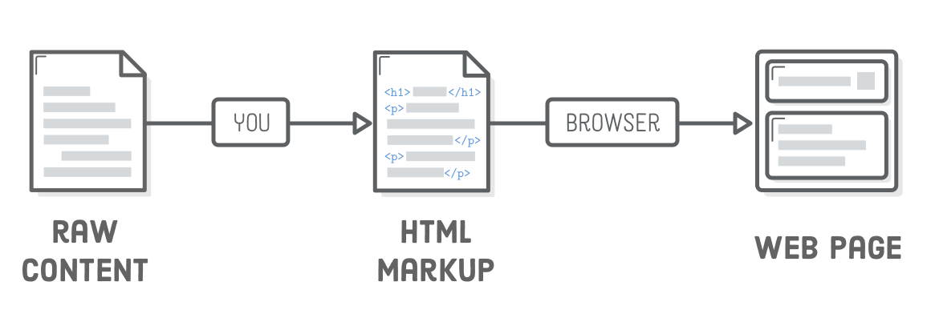
HTML: Markup Process
image source: Oliver James, Interneting Is Hard

Slide 13

HTML: Tags for Paragraphs and Text Styling
Paragraphs are denoted by <p>
Element =
opening tag = <p>
closing tag = </p>
Italics are denoted by <i> or <em>
Bolded are denoted by <b> or <strong>
Block quotes are denoted by <blockquote>
Line breaks are denoted by <br>
<br> presents a rare case in which an HTML element does not require a closing tag

Slide 14
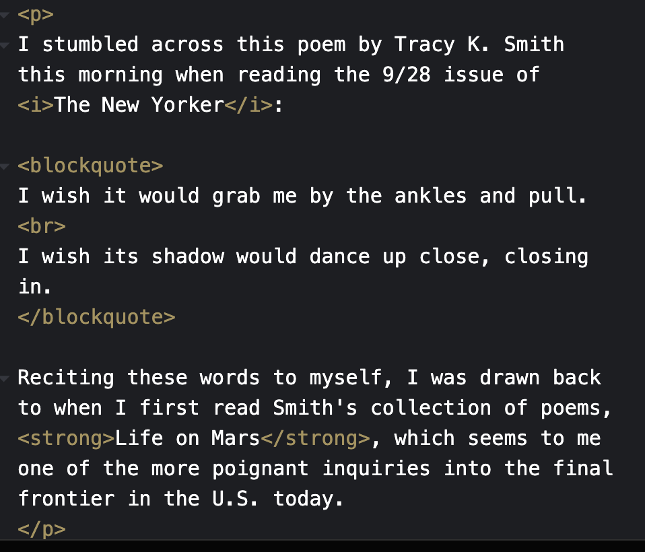
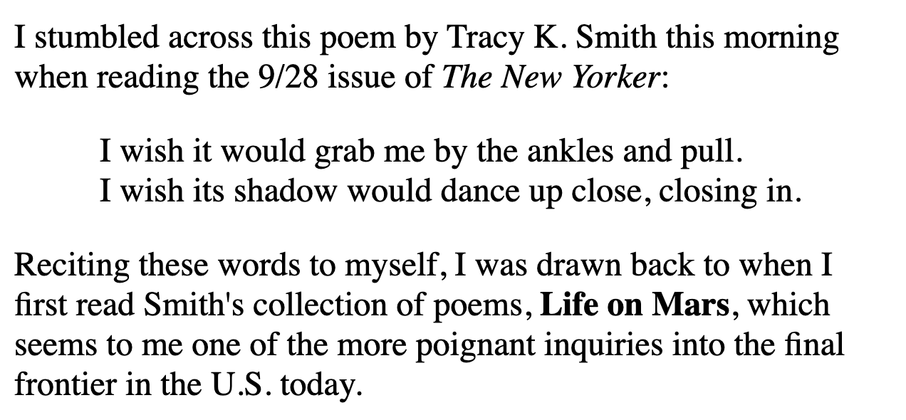
HTML: Code Snippet: Practice!
Practice with paragraph and text styling tags using the online code editor linked here: https://codepen.io/pen/
Use this text, or make your own while retaining the formatting

Slide 15
HTML: Tags, The Basic Structure of a Web Page
<html> = opens page for HTML code
<head> = opens metadata field
</head> = closes metadata field
<body> = opens visible page content
</body> = closes visible page content
</html> = closes page for HTML code
be sure to check that you have closed all of your brackets and tags
Return to your code snippet (via https://codepen.io/pen/) to add these tags, and to layer any existing paragraph content between the <body> and </body> tags

Slide 16
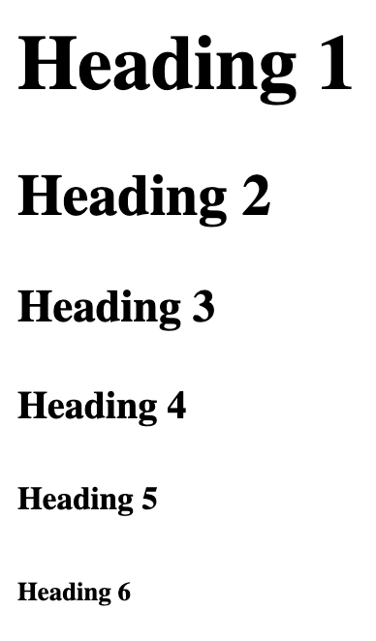
HTML: Tags, Titles, and Headings
Page titles are denoted by <title>
shows up in browser tab
located under <head> as metadata
Heading levels span <h1> to <h6>
sorts headings and subheadings
located under <body> as body content
Now return to your code snippet to add a title and a heading, making sure to layer these elements correctly. Remember:
title tags between <head> and </head>
h1-h6 tags between <body> and </body>
Example: https://bit.ly/33u0QNx
<h1>Heading 1</h1>
<h2>Heading 2</h2>
<h3>Heading 3</h3>
<h4>Heading 4</h4>
<h5>Heading 5</h5>
<h6>Heading 6</h6>
These are pre-defined within HTML; you can modify with CSS

Slide 17
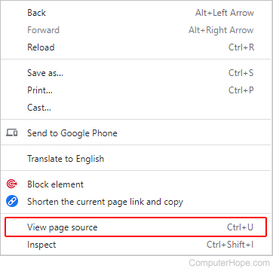
HTML: Viewing Page Sources
Now that you have more of a grasp on how HTML uses tags to “mark up” content on the web, take a glimpse behind the veil and see for yourself:
Early-stage websites are more legible given their exclusive use of HTML
So let’s visit an old-school website (last updated in 1994): http://www.pmichaud.com/toast/
When you’re ready:
right-click or control+click anywhere on the page
click “view page source”
try reading its HTML source code
share what stands out to you

Slide 18
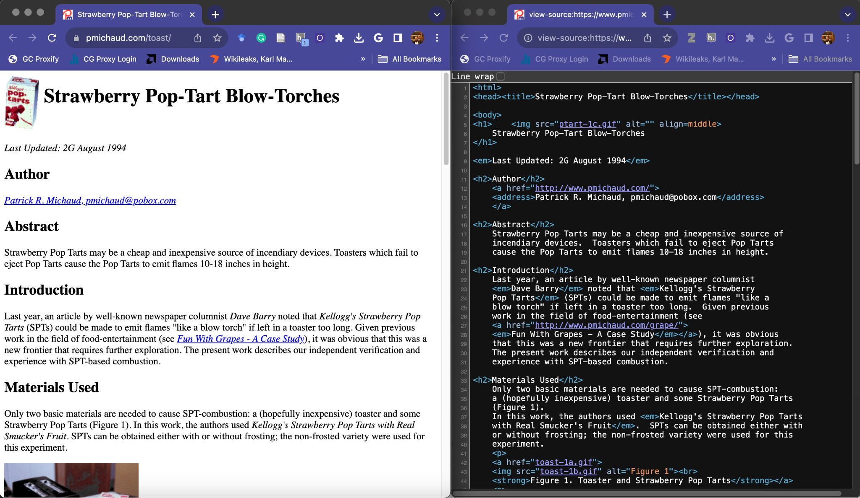
HTML: Viewing Page Sources
It is recommended that you display the page and the source side by side, in different

Slide 19

HTML: Comments & Page Version Histories
HTML code itself does not contain histories of its changes, but a website might contain an edit history log.
An author may include notes about changes using the comment tag, which looks like this <!-- —->
Example:
A comment is not processed by the web browser, meaning the text contained within it is not fed as instructions for markup. Try adding one to your code snippet.
Another way to check for changes and a version history is the Internet Archive’s Wayback Machine, which you can access here https://archive.org/web/

Slide 20
Creating a Coding Environment & Website Folder
This is an essential step to coding. Remember, HTML combines connects referenced information.
Minimize all your windows so only your computer desktop remains
Click File >> New Folder >> name that folder "website”
Open Finder >> select Applications >> open your preferred text editor
e.g. TextEdit (MacOS), Notepad (Windows)
Click New Document (or click File >> New)
Click Format >> Press Make Plain Text (this is an essential step)
Copy and paste your HTML code from codepen into the new file
Click File >> Save >> title your new file "index.html"
Click “Save” with your “website” folder as the file’s directory

Slide 21
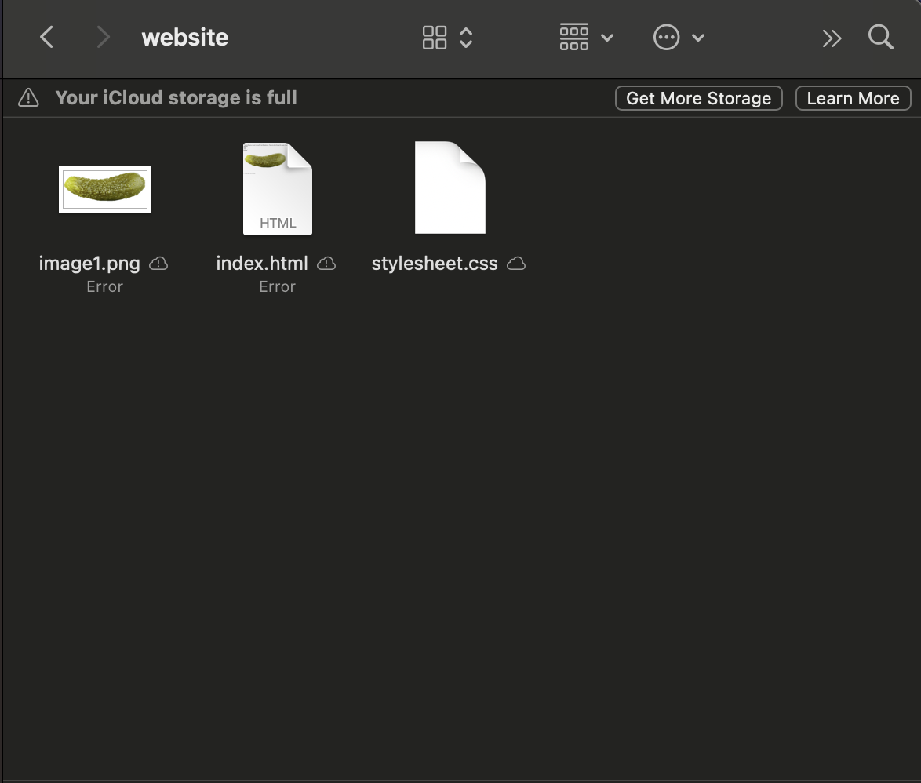
Coding Environment: Example
Simply put, it’s a folder that contains everything (which may include sub-folders)

Slide 22
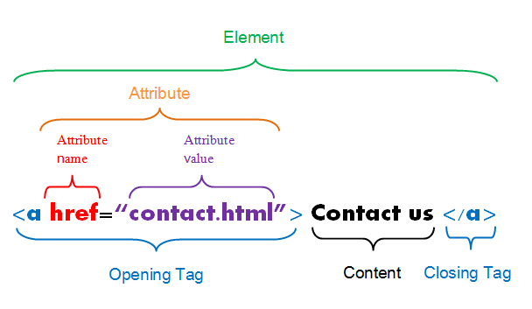
HTML: Tags for Links - Hypertext
The <a> tag links users to another file in your your Website folder — but more on that in a bit
The href part of the opening tag, known as the attribute name, indexes the title of your intended file, known as the attribute value
href = hyperlink reference
The attribute must be be contained in “ “
The example on the right yields the following hyperlink: Contact us

Slide 23
Working with Links in a Local Directory
When linking to another page on your website, you need to save that other page in the same folder as the page in which you're embedding an intended hyperlink
If you want to embed a link in your "index.html" file that yields an image file, then you would first need to save that image file in “website” folder where "index.html" lives
Let’s try it out…

Slide 24


Linking to Images in a Local Directory
You can call upon an image file with the <img> tag by using the src attribute to index the title of that image file:
In order to use this tag, follow these following steps:
create a new document, save it to your "website" folder as "image1.html”
copy/paste <img src="image1.png"> in your “image1.html” file, save your work
download an image file, save it to your "website" folder as "image1.png"
return to your "index.html" file to embed a link to the "image1.html" file
example:
save your work and open "index.html" in your browser to see if your link works

Slide 25
Cascading Style Sheets (CSS)
HTML separated document structure and layout. Layout, by default, was often determined by the browser.
First proposed in 1994 by Håkon Wium Lie. First version invented in 1996.
Goal of CSS was to create a universal style selector for the Web, improve visual design.
Sets rules for how the layout and design elements of HTML should be rendered in your browser
i.e. CSS dresses up web pages using “rule sets” established in a stylesheet
Adaptable across web pages, browsers, tablets, devices, screen sizes, and more.
Radically improved the efficiency with which developers built visually appealing websites
CSS has a cascading effect in how CSS rules establish an order of precedence that instructs browsers how to style HTML elements
Notes:
An enormously efficient solution given the fact that HTML was not originally meant to offer tags equipped to format content on a web page

Slide 26

CSS: Syntax and Rule-Set
CSS presents a rule-set consisting primarily of selectors and declaration blocks
selectors index the tag assigned to HTML element(s) that you want to style
declaration blocks provide a series of declarations
Each block is: enclosed in curly brackets
separated by a semicolon
Declarations include both a property name and a property value (name/value pair)
Image credit: https://www.w3schools.com/css/css_syntax.asp

Slide 27
CSS: Incorporating Stylesheets
Three ways to use CSS stylesheets to style HTML files
Internal CSS (example)
Inline CSS (example)
External CSS (example)
Nested under the <head> element of an HTML document
Employs a <link> tag to call on the CSS stylesheet to style your HTML file
Example: <link rel="stylesheet" type="text/css" href= "style.css">
<link> elements present yet another a rare case in which an HTML element does not require a closing tag

Slide 28
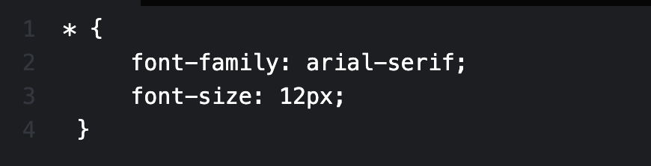
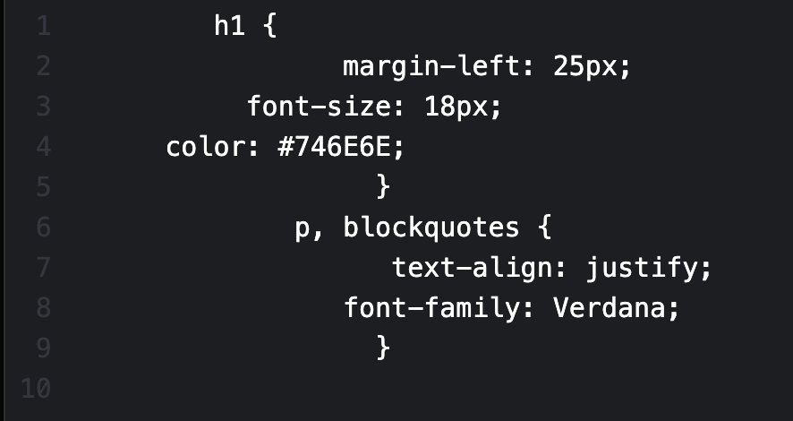
CSS: Selectors and Declaration Blocks
Universal selector * = applies to everything in an HTML document
Type selector = matches or targets element names; multiple selectors can be applied at once

Slide 29
CSS: Employing an External Stylesheet in Your Website Folder
Using TextEdit/Notepad, create a new file >> add one or more selectors to a declaration block, and create declarations for the heading and/or the paragraph elements of your “index.html” file
Save the CSS file as "style.css" to your "website" folder
Open “index.html” then nest the bulleted <link> element under the <head> section so your HTML files will index your CSS stylesheets as metadata
<link rel="stylesheet" type="text/css" href="style.css">
Save your work and navigate to your browser
Click “File” >> “Open File” >> choose “index.html” from your “website” folder
Voila!

Slide 30
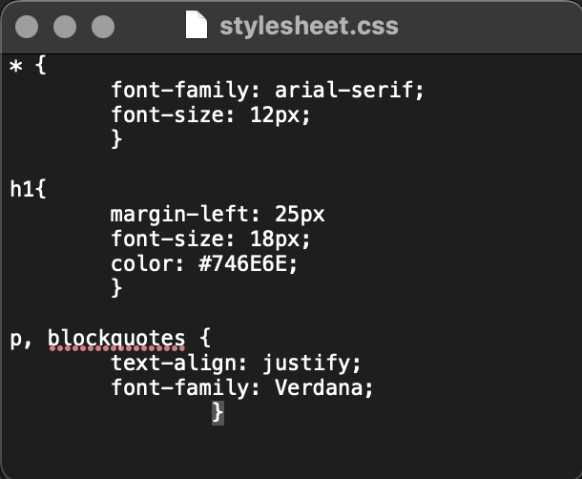
CSS: Code Snippet

Slide 31
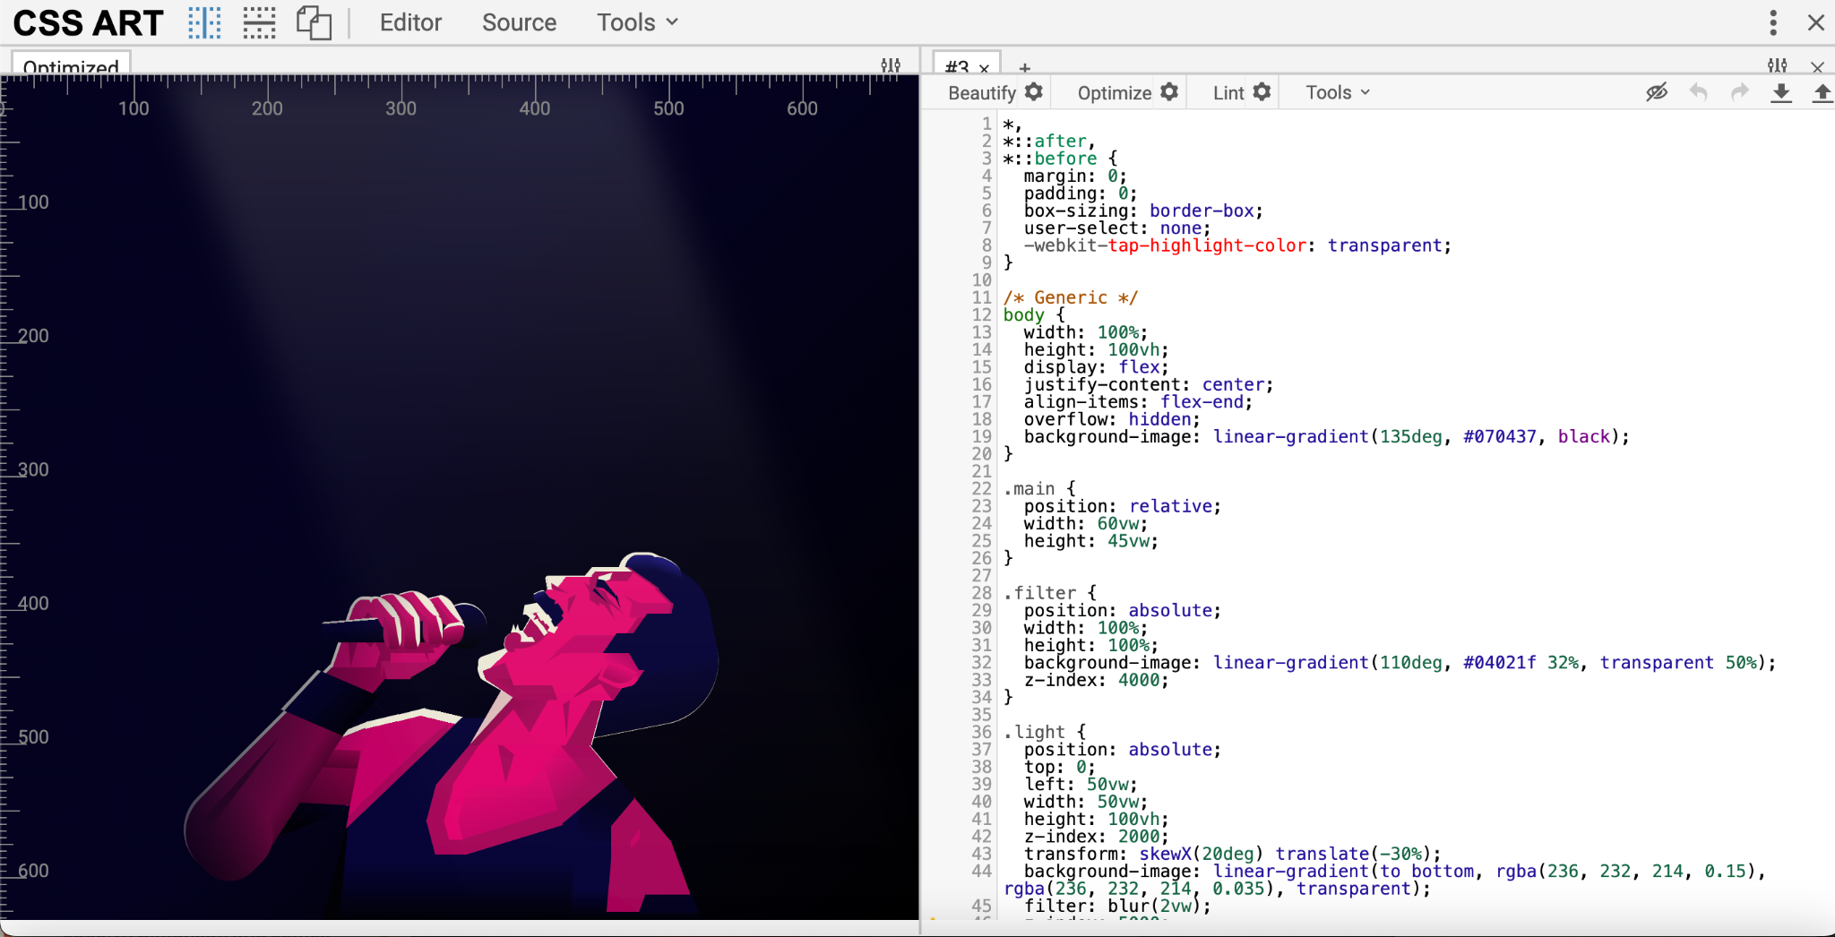
HTML & CSS Art - Ricardo Oliva Alonso, “Freddie Mercury”
https://css-art.com/freddie-mercury-html-css/

Slide 32
Summing it up
Tonight we learned…
A little about the histories of HTML and CSS
How they relate to solving technical problems, and then create their own
How to create a simple HTML script in codepen.io, format and style it, add an image, and add comments.
How to use CSS to create an external stylesheet for an HTML page
How to read a page source and create a desktop coding environment
With these skills, you can build a really simple website
Any lingering questions?

Slide 33
Find a problem or a project
Build something simple & silly
Look at examples!
HTML sites
CSS Zen Garden
CSS Art Gallery
Wikipedia for background reading
HTML, CSS
Moving Forward
Tools & Tutorials
Codepen.io
Online code editor
w3schools.com
HTML Reference, Examples, Exercises
CSS Reference, Examples, Exercises

Slide 34
Interneting Is Hard: HTML & CSS
Created by Oliver James
Free, visually appealing
Excellent conceptual explanations
Good practice from current lesson
The JavaScripting Graduate Student
Created by GC Steven Zweibel (GC librarian) and Zachary Lloyd (GC Digital Fellow)
Incorporates coding practice in user friendly environment; self-paced
Scaffolds from HTML & CSS to JS

